Slide 1
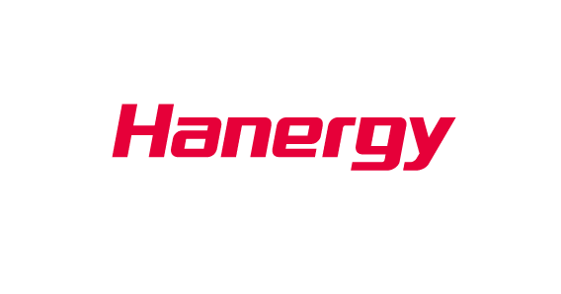
Multi-Scenario Applications Have Become The Trend Of Energy Industry

Slide 2
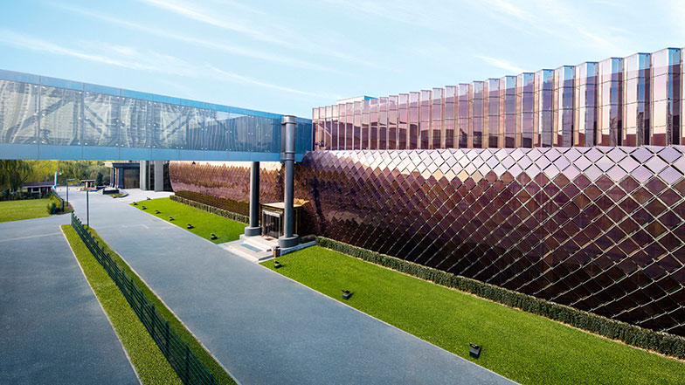
Hanergy Profile
Hanergy is a multinational clean energy company and the world‘s leading thin-film solar power company
Established: 1989
Headquarter: Beijing
Branches: Americas, Europe, the Middle East, Asia Pacific, Africa and other regions
Staff Number: 15000
Hanergy Thin Film Power Group Limited: Listed on the HongKong Stock Exchange (Stock Code: 00566.HK)

Slide 3

GLOBAL TECHNOLOGY INTEGRATION
Solibro Research AB
Uppsala, Sweden
MiaSolé Hi-Tech
Alta Devices
Sunnyvale California, USA
Hanergy Global R&D Center
Beijing, China
Global Solar Energy
Tucson Arizona, USA
Solibro Hi-Tech
Thalheim, Germany
Hanergy BIPV R&D Center
Wujin Jiangsu, China
Hanergy R&D Lab
Chengdu Sichuan, China
Hanergy has successively acquired Germany-based Q-CELLS’s subsidiary Solibro, US-based MiaSolé, Global Solar Energy (GSE) and Alta Devices.
Hanergy has established eight technology research and development bases in Beijing, Sichuan, Jiangsu, Silicon Valley of the United States, Germany and Sweden.

Slide 4

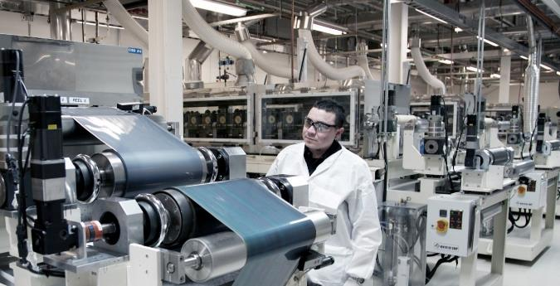
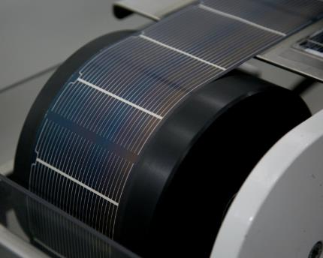
Production Line
Hanergy USA: Global Solar Energy Production Line
Global Solar Energy Cells
GSE’s Technology: Conversion efficiency of 18.7%.
Product Features: With the features of light weight, ultra-thin appearance, flexibility, direct adhesion and low installation cost, it is suitable for lightly loaded and curved roofs, and applicable for the development of civil products.
Target Markets :Mass consumer goods, thin-film solar BIPV, vehicle applications, special products, and electronics.

Slide 5



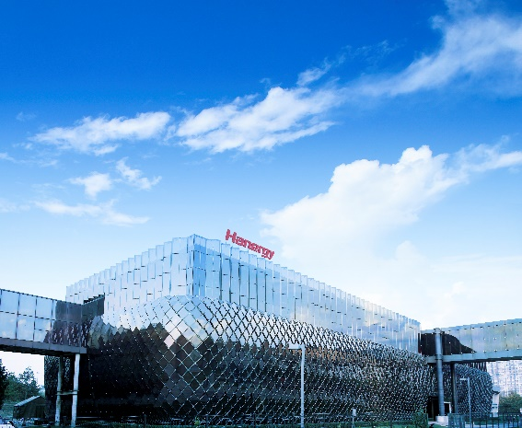


Solar
Advantage
Clean
Eco-Friendly
Pollution

Slide 6

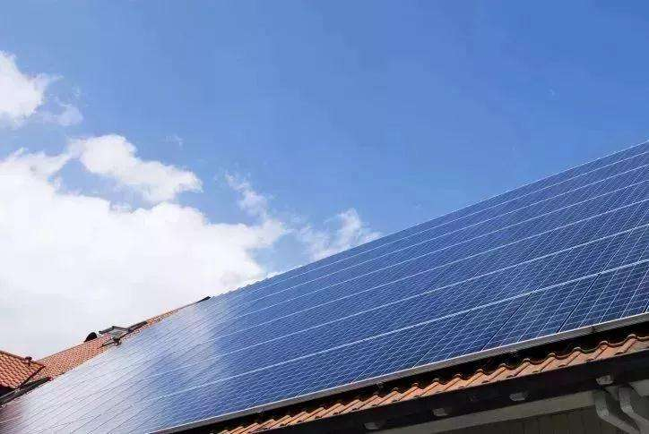
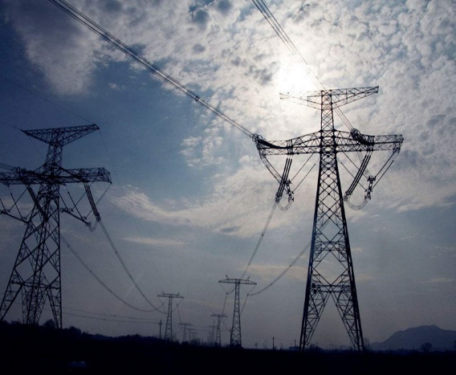
Solar
Defect
High Cost
FIT
Rejection
Transfer Lost

Slide 7
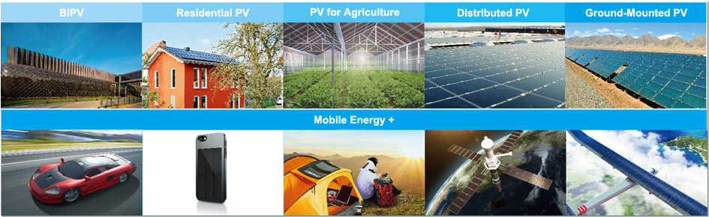
Multi-Scenario Applications

Slide 8
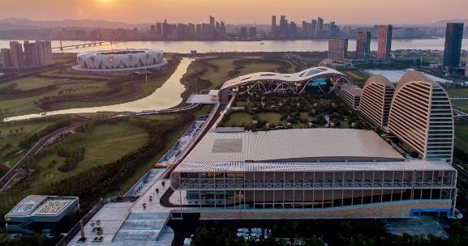
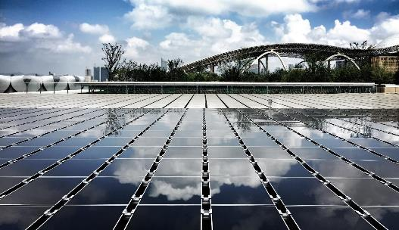
Applications
G20 conference: Hangzhou International Exhibition Center
Built with Hanergy thin-film solar PV products

Slide 9
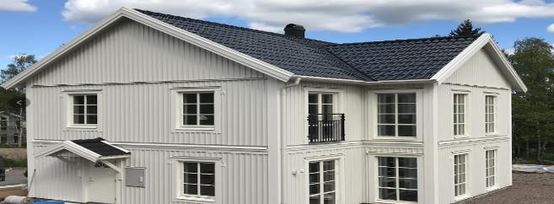
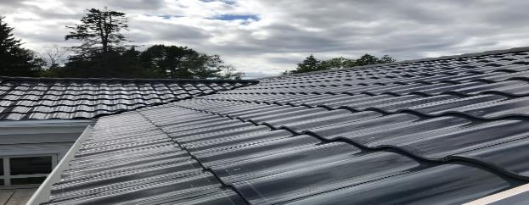
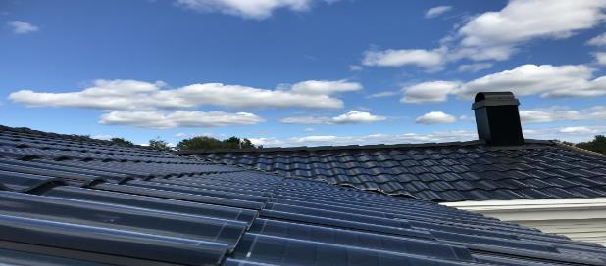
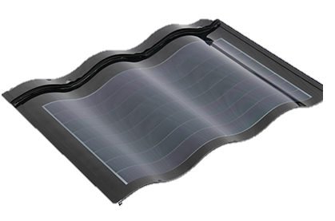
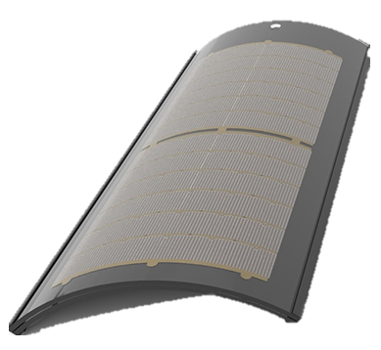
Applications
Stockholm, Sweden Residential PV: Hantile Installed Capacity:36KW

Slide 10
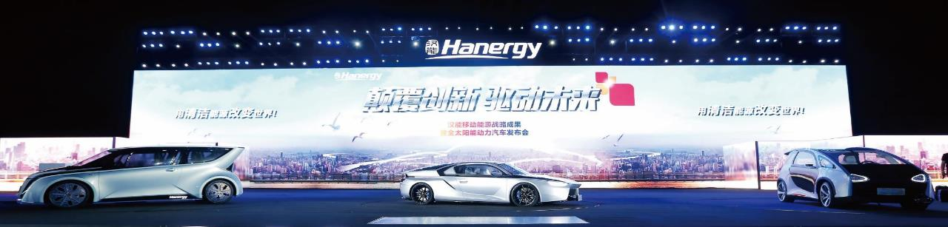

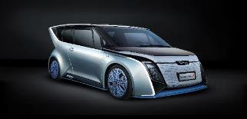
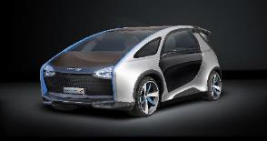
Applications
Hanergy’s fully solar powered vehicle
Solar L
Solar R
Solar A
Solar O

Slide 11
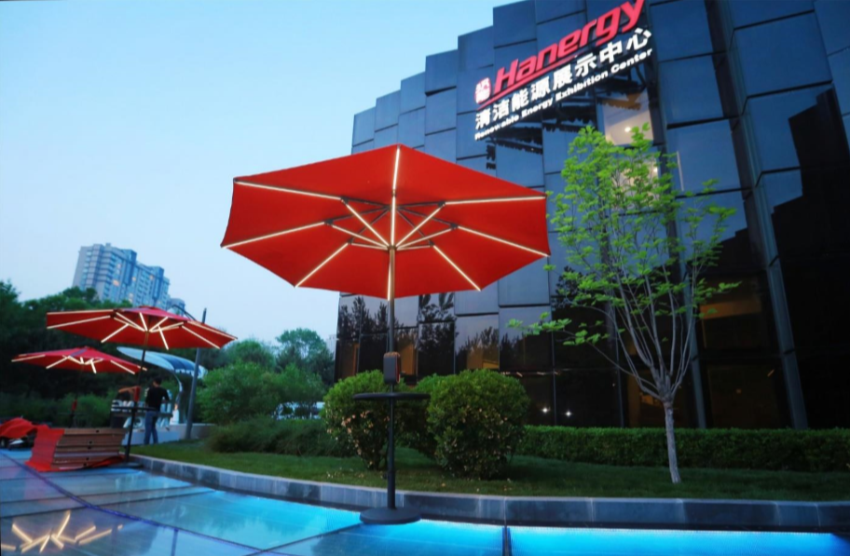
Humbrella

Slide 12
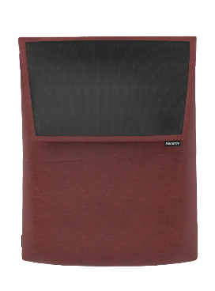

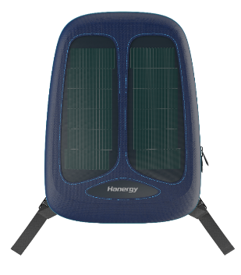
Applications
HanPack
HanPack is a fusion of backpack’s basic functions and advanced solar power technology that has capabilities par excellence to fulfil the immediate requirement of electric power while you’re on the go.
Launch Date: Jun. 2018
Business
Sport
Fashion

Slide 13




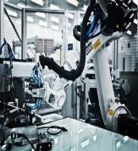
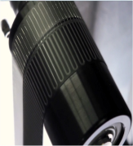
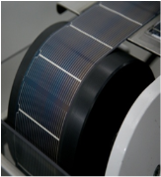
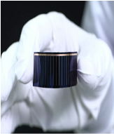
Thin-film power
The era of mobile energy has already come
Our focus on thin film solar: the most advanced solar technology worldwide
Glass-Based CIGS Thin Film
Efficiency: 21%
CIGS Sputtering Thin Film
Efficiency: 19.2%
CIGS Co-evaporation Thin Film
Efficiency: 18.7%
Flexible GaAs Thin Film
Efficiency: 31.6%

Slide 14
Building Mobile Energy
Insert VIDEO of Subversive

Slide 15

be great for the world

